Slide 1
CHAPTER ONE
Definition of software
Software Engineering vs. Computer Science
Failure curve of Hardware and software
Software Myths
Software development life cycle (SDLC)
Software Development methods

Slide 2

Metaphor for Software Development

Slide 3
Software (set of instruction + design diagrams+ necessary databases)
Software Engineering : Creation and design of the software .
Computer Science: Broad approach to the study of the principles and use of computers that covers both theory and application

Slide 4
Characteristics of Software
software has characteristics that are considerably different than those of hardware:
Software is developed ; it is not manufactured (Both process focuses to achieve high quality, for hardware can introduce quality problems that are nonexistent for a software)
Software doesn’t “wear out.”
3. Software is custom build

Slide 5
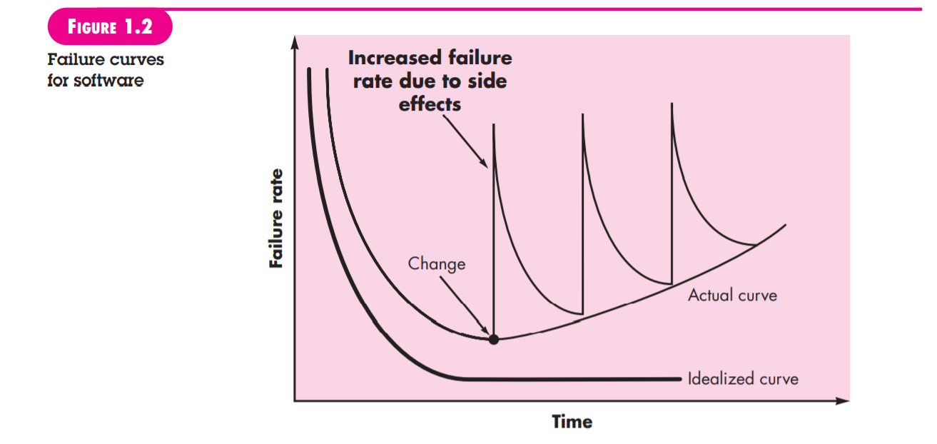
Characteristics of software
2. Software doesn’t wear out but it does deteriorates

Slide 6
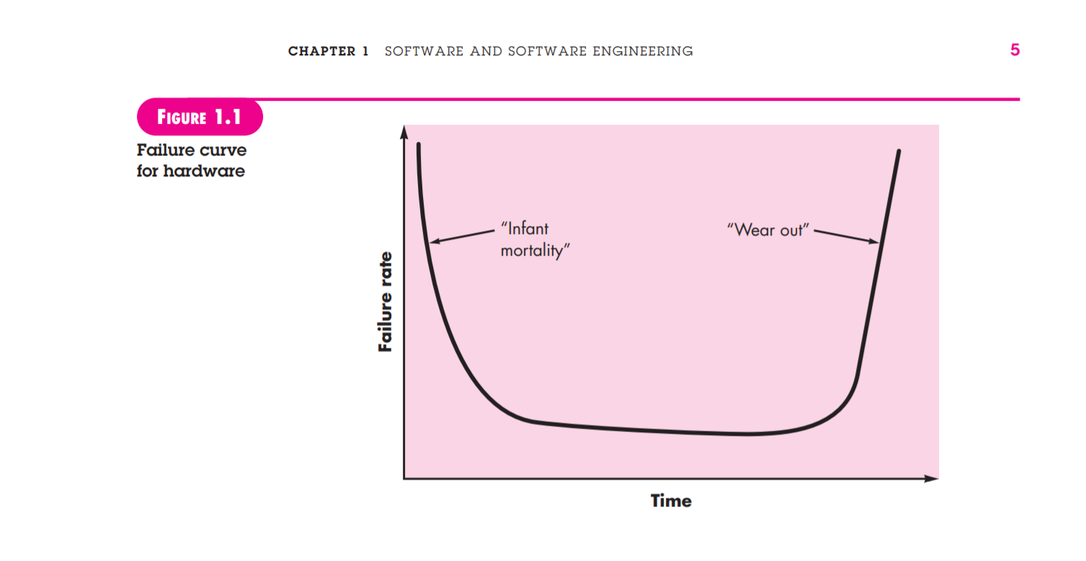
Characteristics of Software
2. Software doesn't wear out but hardware does

Slide 7
Software Myths
Management myths
Myth: We already have a book that’s full of standards and procedures for building software. Won’t that provide my people with everything they need to know?
Reality: Are software practitioners aware of its existence? Does it reflect modern software engineering practice? Is it complete? Is it adaptable?

Slide 8
Software Myths
Management Myths
Myth :If we get behind schedule, we can add more programmers and catch up
Reality :new people are added, people who were working must spend time educating the newcomers, thereby reducing the amount of time spent on productive development effort

Slide 9
Software Myths
Management Myth
Myth: If I decide to outsource the software project to a third party, I can just relax and let that firm build it.
Reality: If an organization does not understand how to manage and control software projects internally, it will invariably struggle when it outsources software projects.

Slide 10
Software Myths
Customer myths
Myth: A general statement of objectives is sufficient to begin writing programs—we can fill in the details later.
Reality: an ambiguous “statement of objectives” is a recipe for disaster.

Slide 11
Software Myths
Customer
Myth: Software requirements continually change, but change can be easily accommodated because software is flexible.
Reality :When requirements changes are requested early (before design or code has been started), the cost impact is relatively small. However, as time passes, the cost impact grows rapidly

Slide 12
Software Myths
Practitioner’s myths.
Myth: Once we write the program and get it to work, our job is done
Reality: Industry data indicate that between 60 and 80 percent of all effort expended on software will be expended after it is delivered to the customer for the first time

Slide 13
Software Myths
Practitioner’s myths
Myth: Until I get the program “running” I have no way of assessing its quality
Reality: Quality focuses from at the time of requirement analysis

Slide 14
Software Myths
Myth: The only deliverable work product for a successful project is the working program
Reality: A variety of work products (e.g., models, documents, plans) provide a foundation for successful engineering and, more important, guidance for software support.

Slide 15
Software Myths
Practitioners Myths
Myth: Software engineering will make us create voluminous and unnecessary documentation and will invariably slow us down.
Reality: Software engineering is not about creating documents. It is about creating a quality product. Better quality leads to reduced rework. And reduced rework results in faster delivery times.

Slide 16
FOUR P’s
Effective software project management focus on Four P’s
People
Product
Process
Project

Slide 17
Four P’s
People
Highly skilled manpower is needed for the software industry
Software industry follows the People Management capability Maturity Model (PM-CMM) to enhance the readiness of software organization.
PM-CMM defines the key practice areas for software: recruiting, performance, training, selection, compensation

Slide 18
Four P’s
Product
Before a project can be planned, product objective and scopes should be established
Only then we can establish accurate estimation of cost, effective project management, risk assessment, scheduling.

Slide 19
Four P’s
Process
An effective software process provides the framework from which comprehensive plan for software development is established.

Slide 20
Four P’s
Project
We conduct planned and Controlled software project for one primary reason – it is the only way to manage the complexity.
Many software projects have failed due to poor management of the project
In order to avoid the project failure a software project manager and the software engineer must develop the commonsense approach for planning, monitoring and controlling the project.

